Slide 1
Introductions
Bill Crim
President & CEO
United Way of Salt Lake
bill@uw.org
Jonathan Feinstein
Director of Community Engagement
Commit! Partnership
Jonathan.Feinstein@commit2dallas.org
Martha Rodriguez
Program Manager
Bachman Lake Together
rdgz1997@sbcglobal.net
Notes:
Alphabetical order by last name
Speakers explain why community engagement matters to them and why they’re excited to lead this workshop (90 sec each)

Slide 2
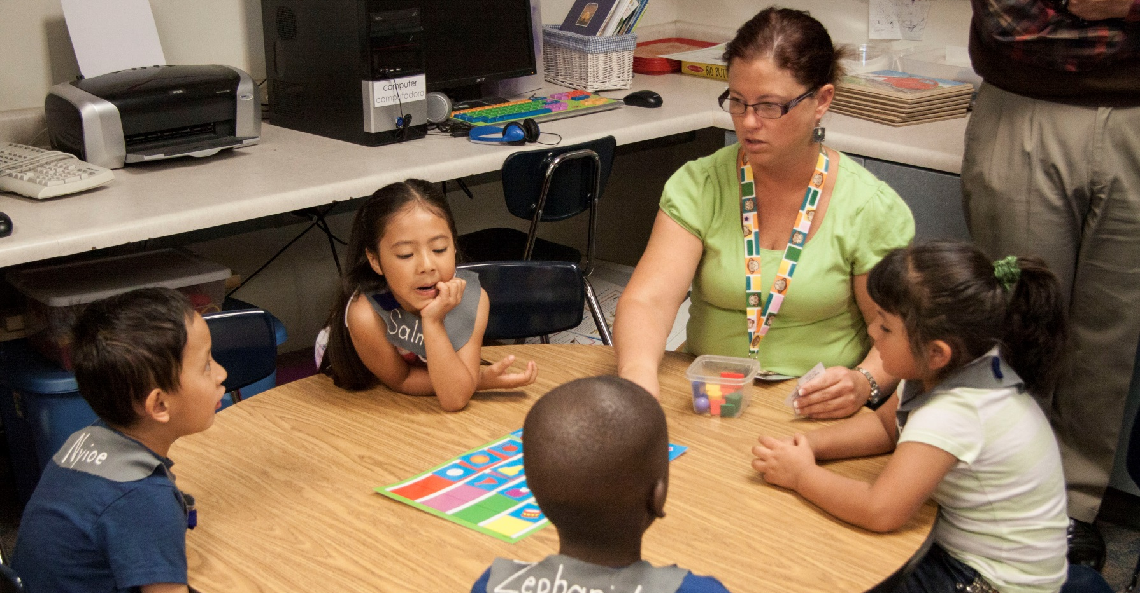
UWSL Promise Partnerships

Slide 3
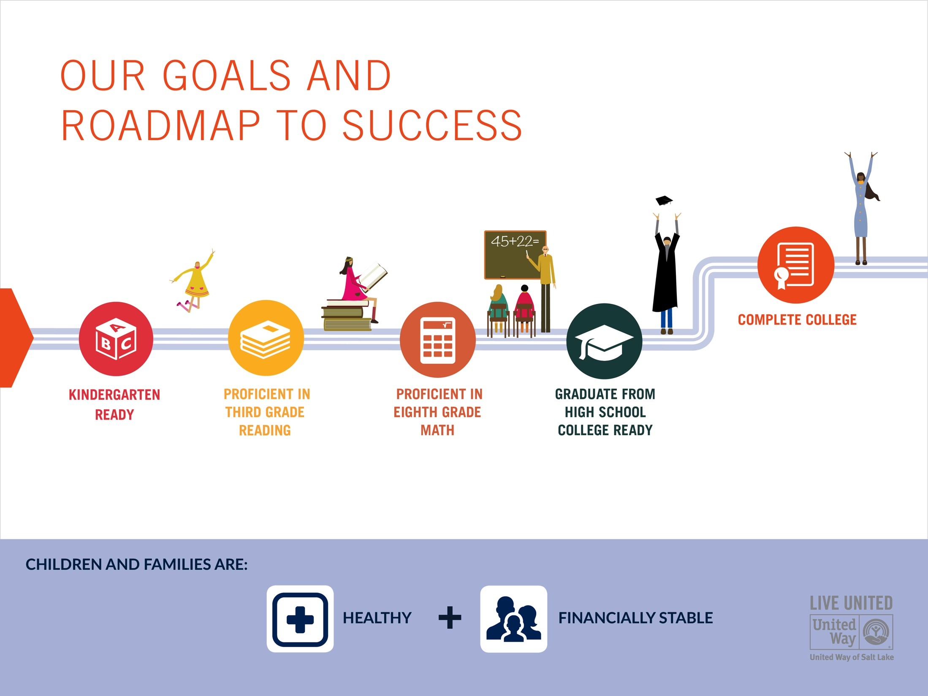

Slide 4
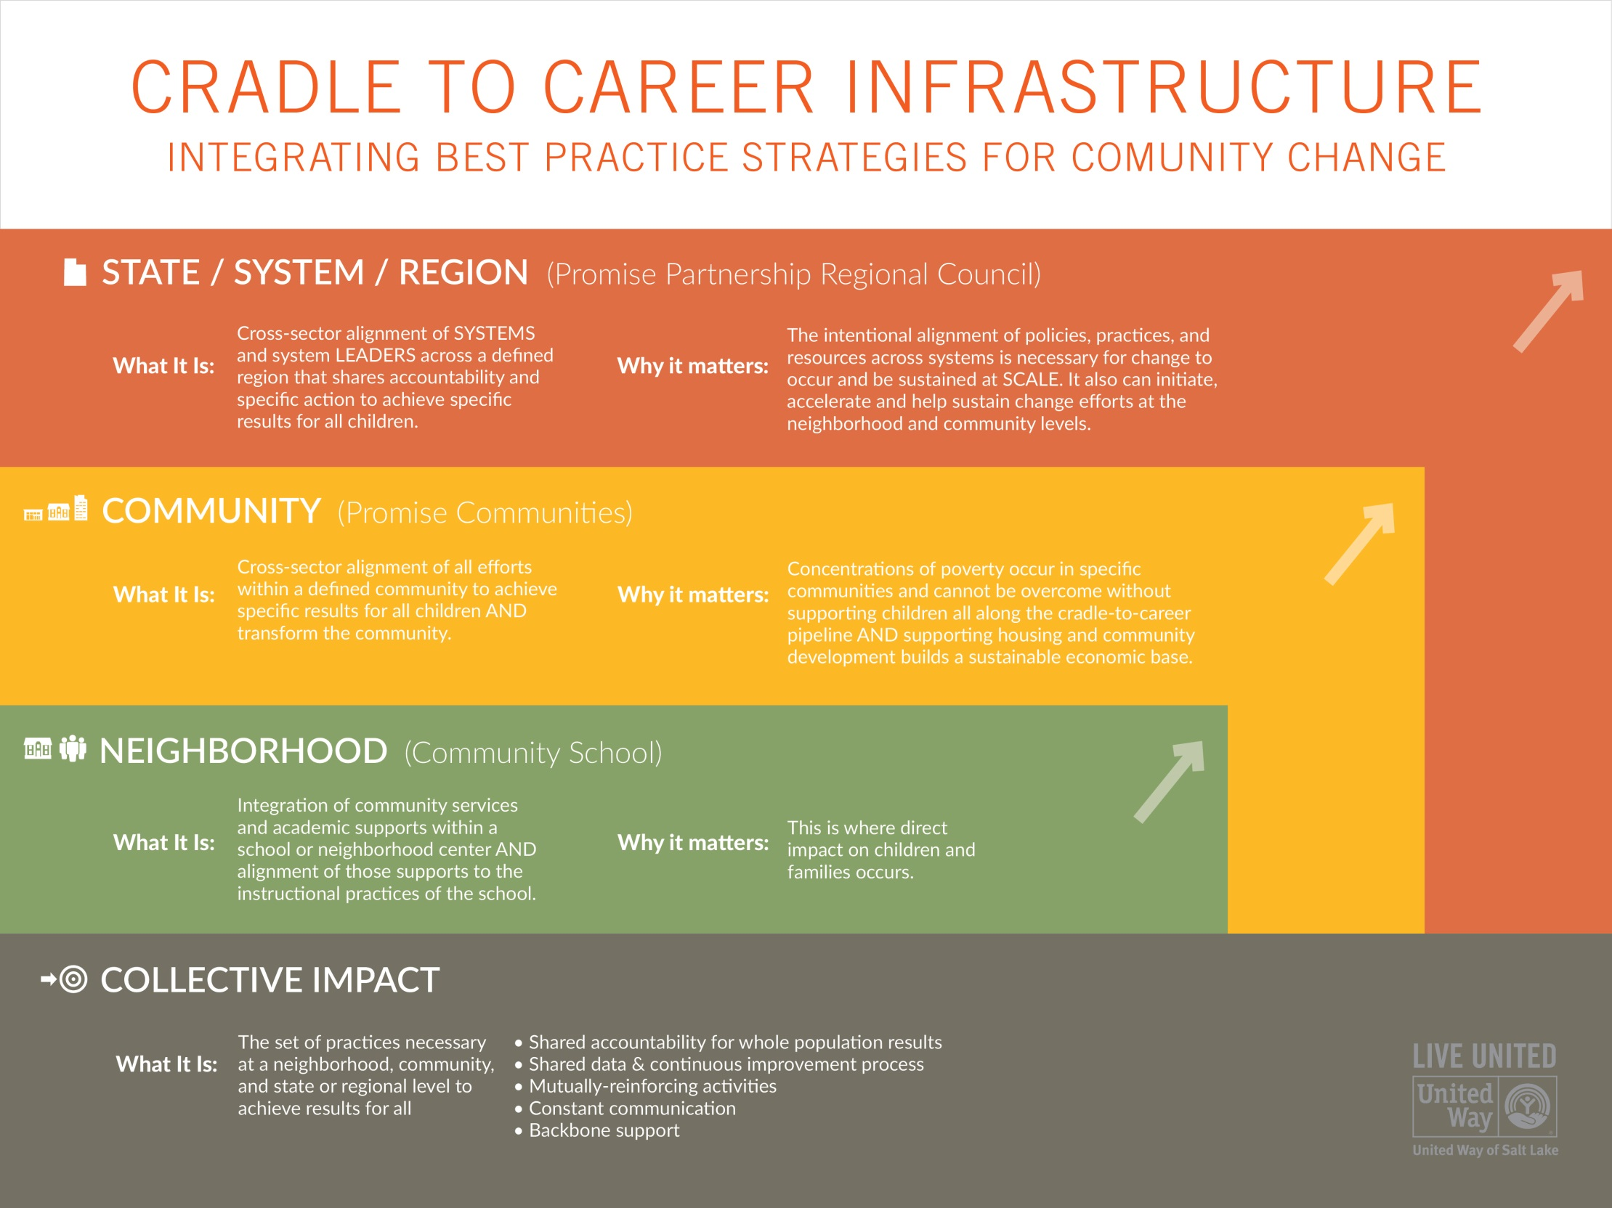

Slide 5
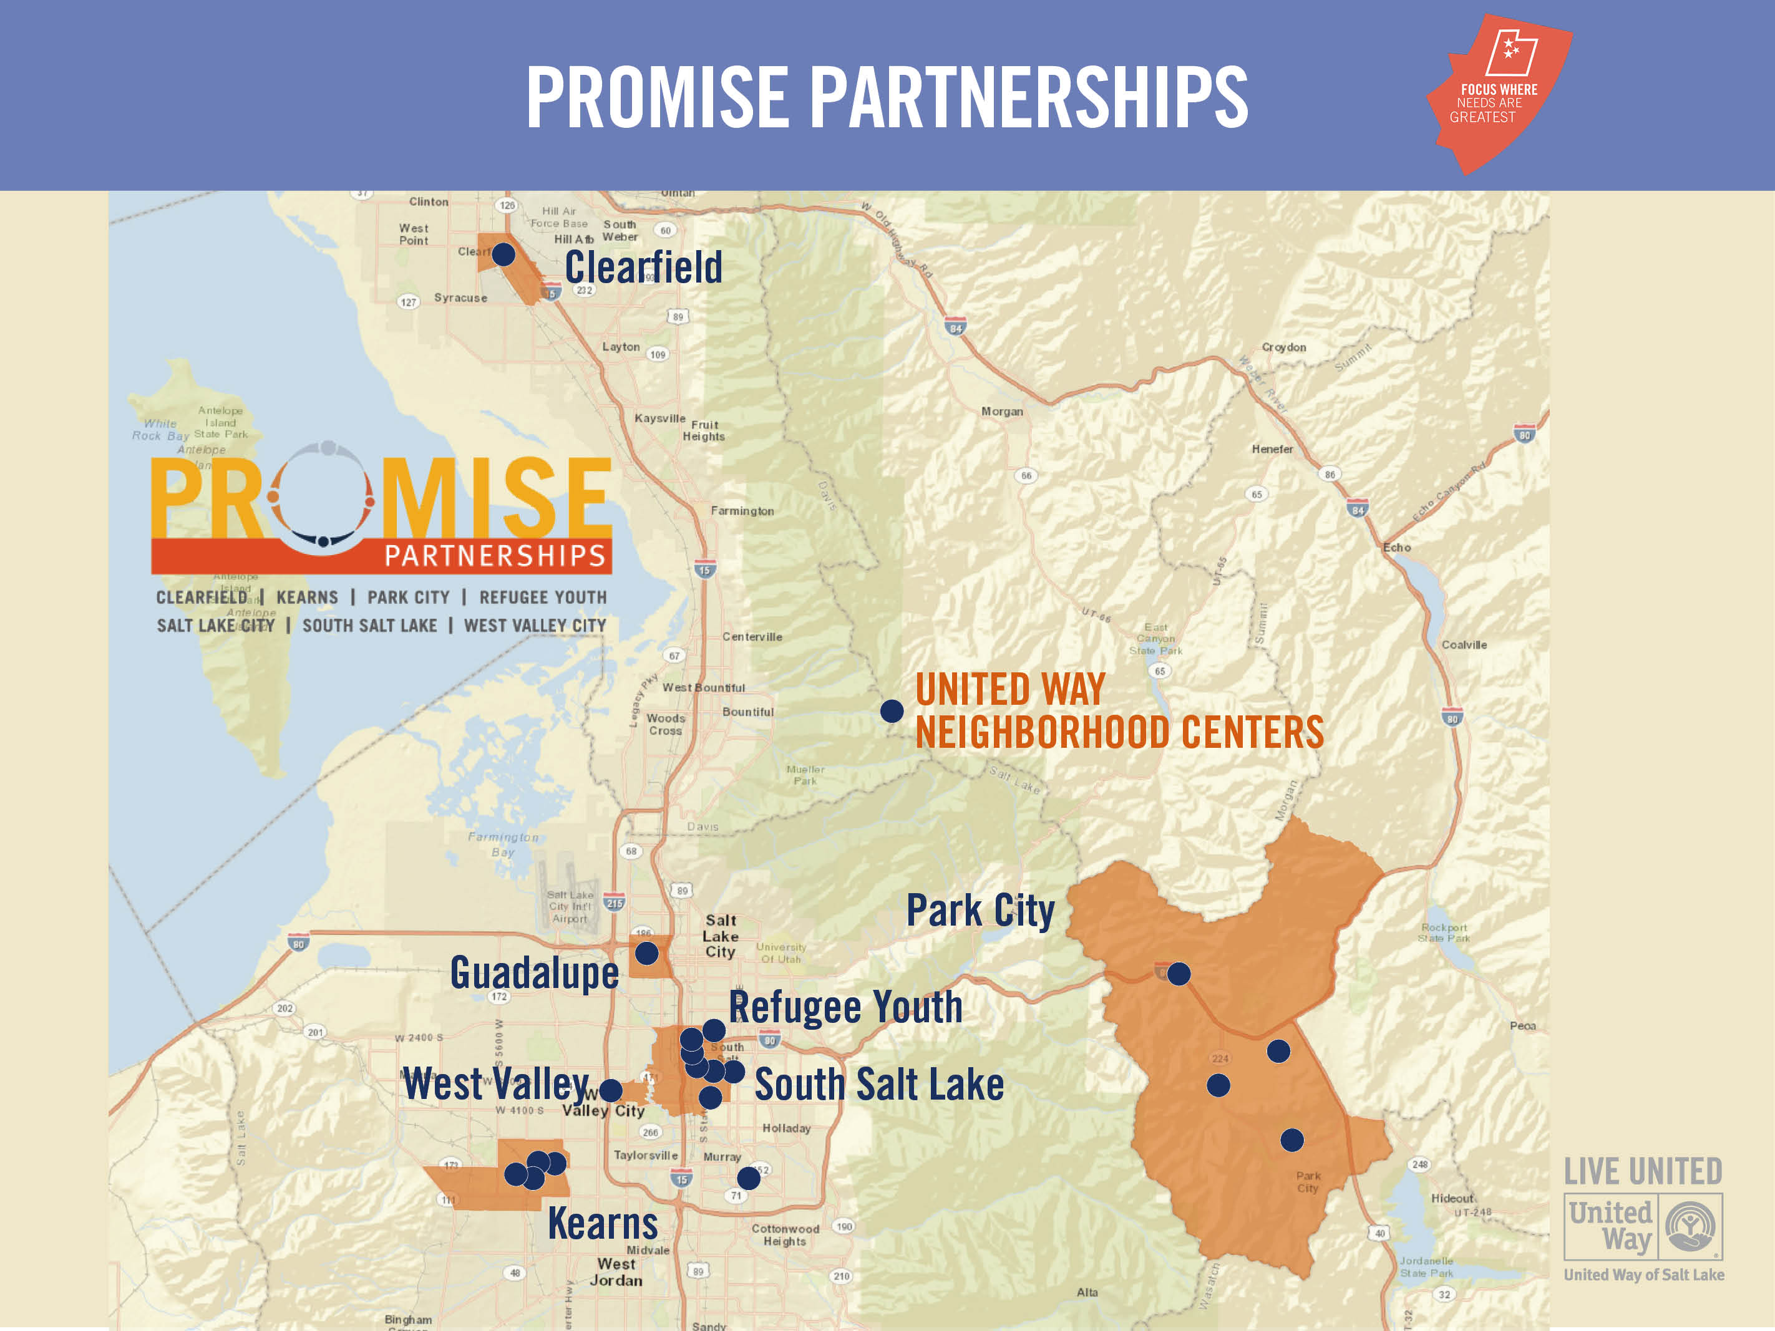

Slide 6
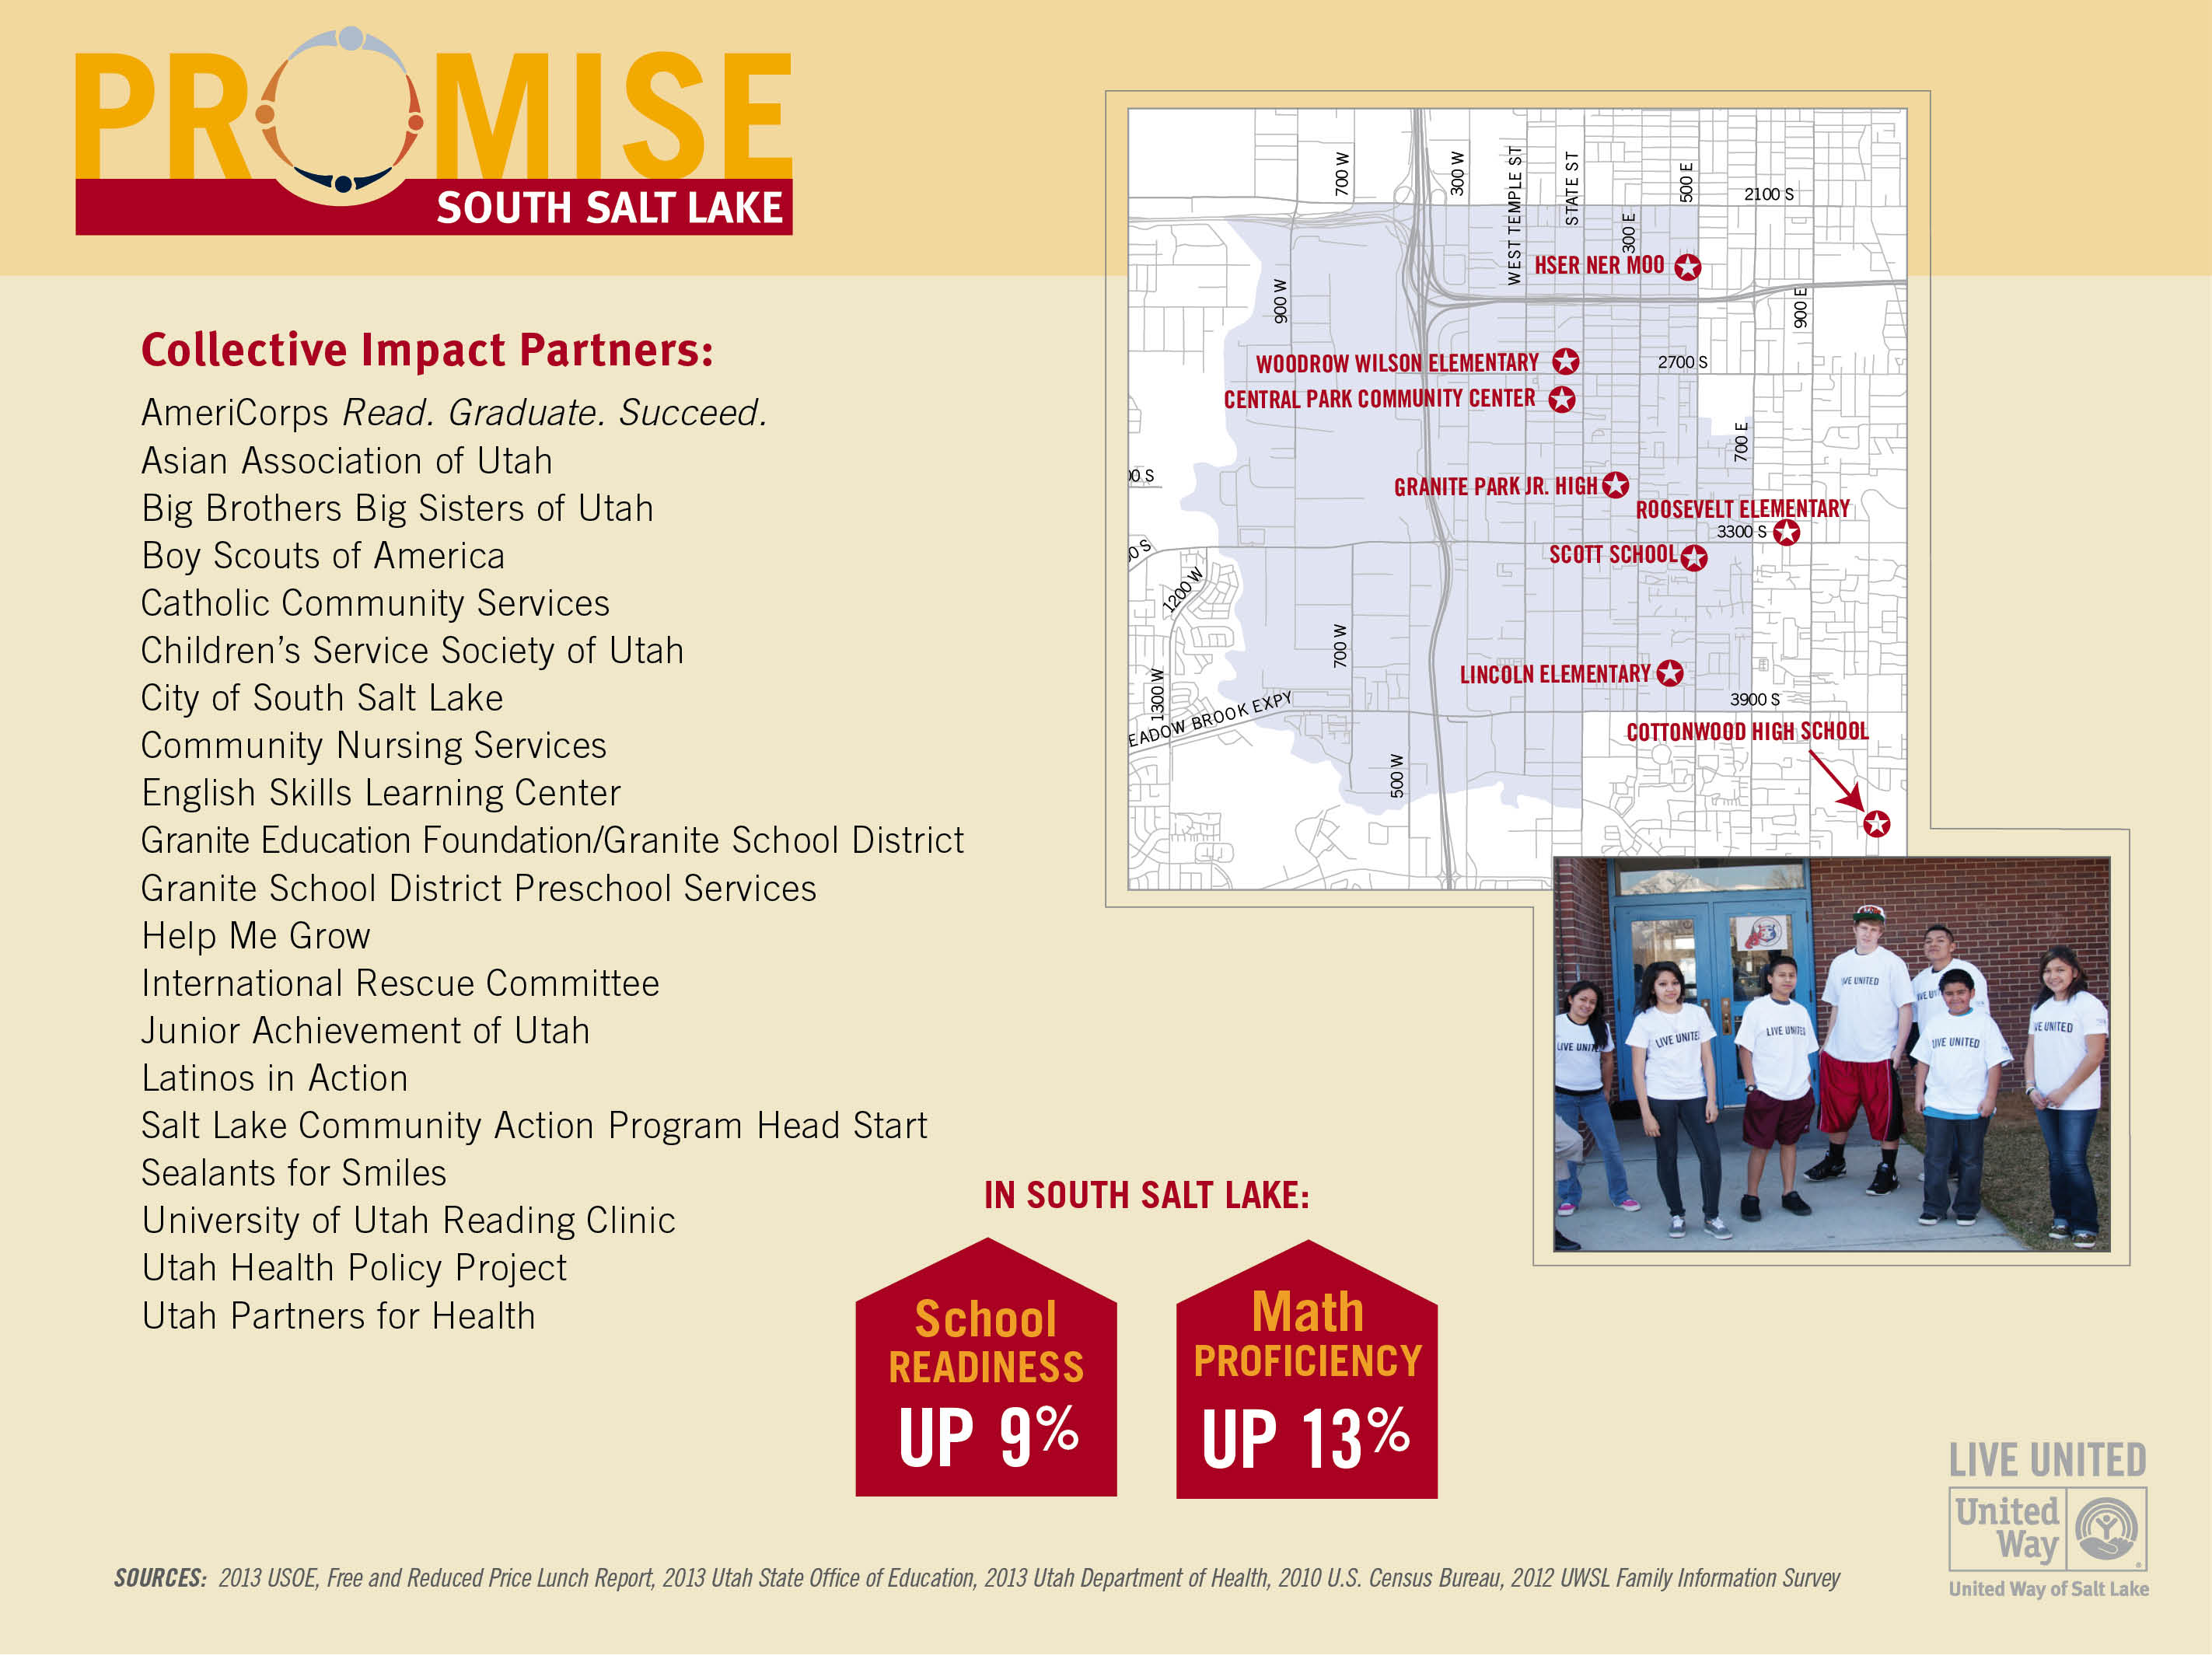

Slide 7
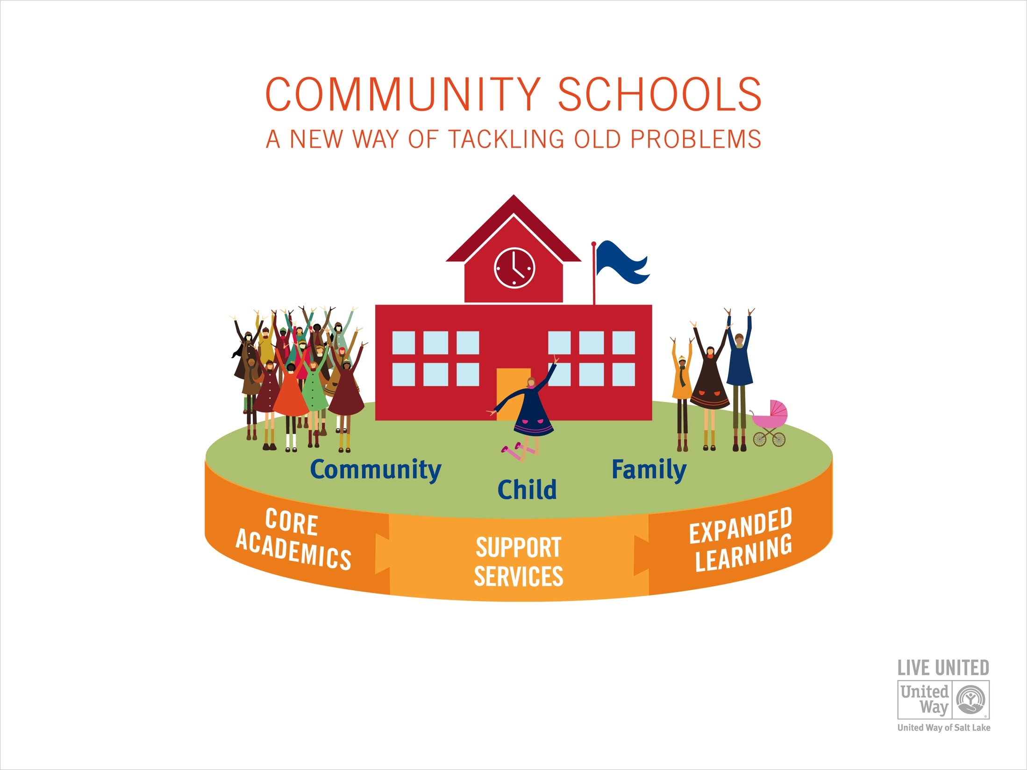

Slide 8
Integrated Infrastructure
District
System
Region
County / State Policy Initiatives
SL County PreK
State PreK and Collective Impact
Collaborative Action Networks
Early Learning
3rd Grade Reading
College Access
School Mobility
S. Salt Lake
Kearns
WVC
Park City
Clearfield
Midvale
Cottonwood
Kearns High
Granger HS
Park City HS
Clearfield HS
Hillcrest HS
Granite Park
Kearns Jr
Westlake Jr
Treasure Jr
N. Davis Jr
Midvale Middle
Valley Jr
Ecker Middle
Jefferson Jr
Stansbury
Beehive
Valley Crest
Bacchus
Armstrong
Bridger
Redwood
Diamond Ridge
Monroe
Western Hill
Hillsdale
West Kearns
Farnsworth
Doxey
Roosevelt
Gourley
Frost
McPolin
S. Clearfield
Midvale
Lincoln
Fox Hills
Pioneer
Jeremy Ranch
Antelope
E. Midvale
Woodrow
Oquirrh Hills
Rolling Meadows
Trailside
Holt
Copperview
Moss
S Kearns
Granger
Parley’s Park
Wasatch
Sandy
Guadalupe
Notes:
Add Number of students in each school and number we’d reach if we were full feeder pattern
From Danya- We're serving 20,500 across the schools if you include the secondaries schools in PC and CSD. If you don't, we are serving 14,740
South Salt Lake: 4,571 students (current and full pipeline)
Kearns: 3,632 students (current), 9,667 students (full pipeline)
West Valley: 971 students (current), 12,064 students (full pipeline)
Park City: 2,036 students (current), 4,739 students (full pipeline)
Clearfield: 1,015 students (current), 5,548 students (full pipeline)
Midvale: 5,424 students (current and full pipeline)
Guadalupe: 248 (current and full pipeline)

Slide 9
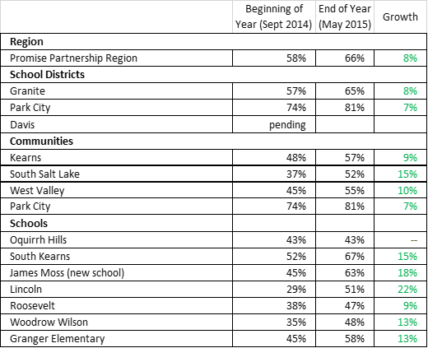
3rd Grade Reading - DIBELS
As measured by DIBELS, the % of 3rd graders proficient increased in every school and every community
Notes:
KOREY – Amy sent the DIBELS data for Wasatch and Holt and the District last night. Will you add it please and recreate this table in powerpoint?
WAITING FOR DIBELS DATA FROM PC AND DAVIS

Slide 10
Eighth Grade students at Community Schools grew as much or more than 8th graders statewide on Math

Slide 11
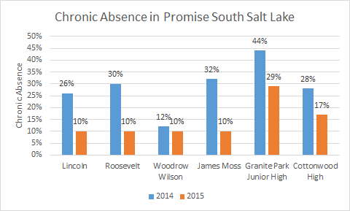
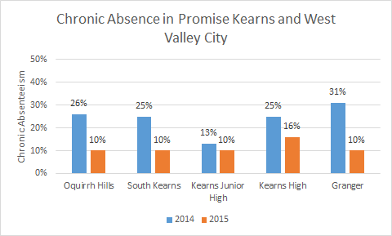
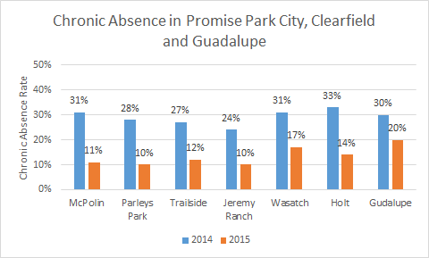
Chronic Absenteeism Declined

Slide 12
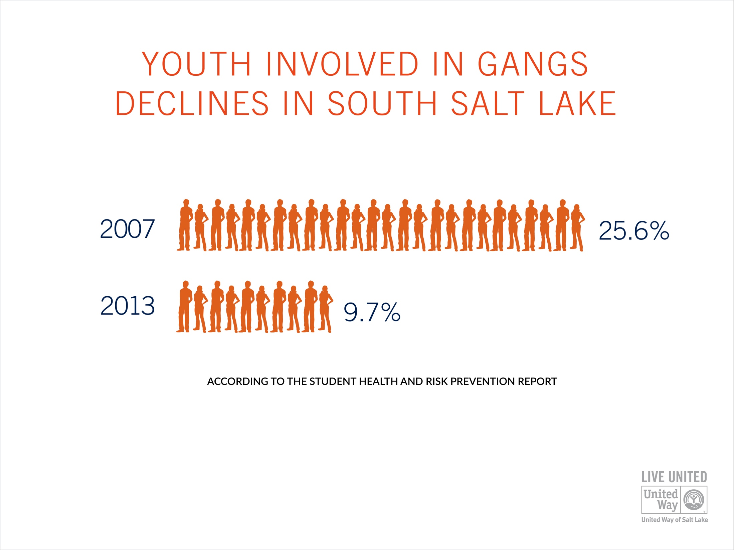

Slide 13
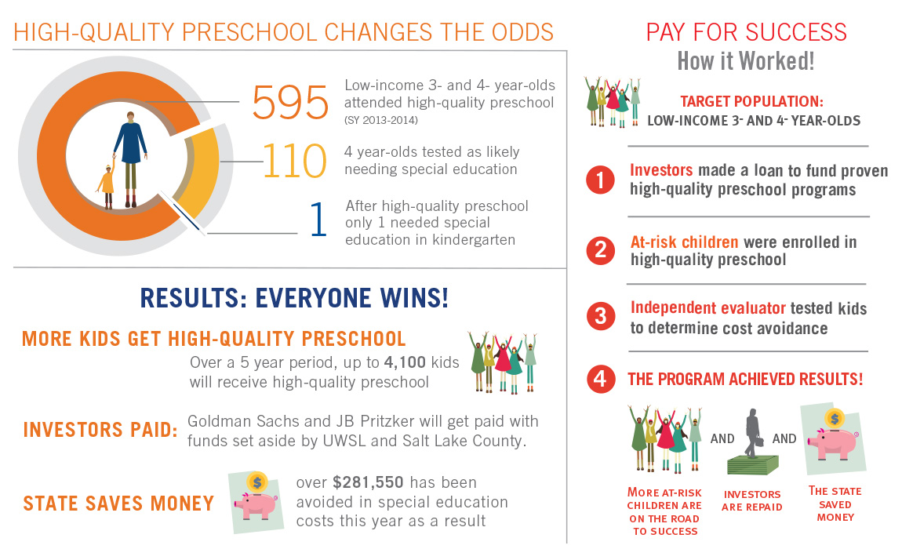
Moving to Scale

Slide 14

The Commit! Partnership
Educational Collective Impact, from Cradle to Career
Dallas County
750,000+ students
Nearly 170 partners
Notes:
An independent nonprofit and Partnership of 160 nonprofits, districts, colleges, and many other entities focused on helping drive student achievement from birth through career, focusing on the 750,000+ students in Dallas County. The largest of 61 organizations like it in the country.

Slide 15
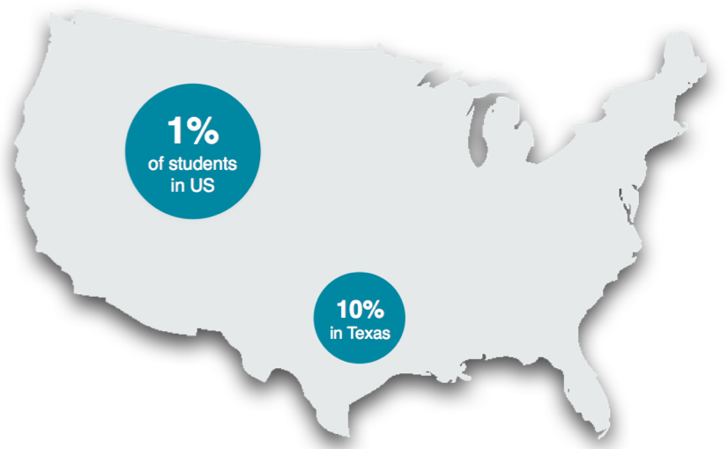
Dallas County in Context
Notes:
Dallas County itself is 1% of the U.S. It’s meaningful

Slide 16


11 Cradle to Career Community Outcomes
Anchor our Work
Pre-K Enrollment
3rd Grade Reading
8th Grade Science
College Readiness
Postsecondary Enrollment
Postsecondary Completion
Kindergarten Readiness
4th Grade Math
Algebra I
High School Graduation
Postsecondary Persistence
Notes:
We take a pipeline view from cradle to career, tracking 11 indicators from pre-K to college completion crucial in a child’s journey.

Slide 17
Opportunities across the Pipeline
Dallas County achievement
82%
(76% of eligible low income students)
83%
62%
55%
48%
36%
35%
32%
32%
30%
14%
Pre-K4 Students Enrolled¹
Kinder Ready¹
3rd Reading²
4th Math²
8th Science²
Algebra I²
College Ready³
HS Grad %⁴
College Enroll-ment⁵
College
1st Yr Peristence⁵
College 6-Yr Comple-tion⁵
1)Texas Education Agency (TAPR) and Commit! Partner Districts (districts providing Kindergarten Readiness data include: Cedar Hill ISD, Coppell ISD, Dallas ISD, DeSoto ISD, Grand Prairie ISD, Highland Park ISD, Irving ISD, Mesquite ISD, Richardson ISD, and Uplift Ed). 2) Achievement levels represent percentage of students achieving Postsecondary Readiness standard (3rd thru Algebra 1) on 2014 STAAR exams. 3) Source: Texas Education Agency (TAPR). Per TEA, SAT/ACT college readiness equivalent to 1100 on SAT Reading/Math subject tests or 24 on ACT. Minimum 100 graduates. 4) TEA: Federal Graduation Rate calculation from accountability standards. 5) Postsecondary data: National Student Clearinghouse from Commit! Partner Districts (districts providing PSE data include – Coppell ISD, Dallas ISD, DeSoto ISD, Grand Prairie ISD, Highland Park ISD, Irving ISD, Mesquite ISD, Richardson ISD, and Uplift Ed.
Notes:
We take a pipeline view from cradle to career, tracking 11 indicators from pre-K to college completion crucial in a child’s journey.

Slide 18
Opportunities in the Pipeline
Dallas County achievement
A child’s Readiness for Kindergarten appears to limit subsequent achievement
Just over 1 in 3 3rd grade students reads at a college-ready rate; such students are then 4x more likely to drop out of high school
82%
(76% of eligible low income students)
83%
62%
55%
48%
36%
35%
32%
32%
30%
14%
Pre-K4 Students Enrolled¹
Kinder Ready¹
3rd Reading²
4th Math²
8th Science²
Algebra I²
College Ready³
HS Grad %⁴
College Enroll-ment⁵
College
1st Yr Peristence⁵
College 6-Yr Comple-tion⁵
1)Texas Education Agency (TAPR) and Commit! Partner Districts (districts providing Kindergarten Readiness data include: Cedar Hill ISD, Coppell ISD, Dallas ISD, DeSoto ISD, Grand Prairie ISD, Highland Park ISD, Irving ISD, Mesquite ISD, Richardson ISD, and Uplift Ed). 2) Achievement levels represent percentage of students achieving Postsecondary Readiness standard (3rd thru Algebra 1) on 2014 STAAR exams. 3) Source: Texas Education Agency (TAPR). Per TEA, SAT/ACT college readiness equivalent to 1100 on SAT Reading/Math subject tests or 24 on ACT. Minimum 100 graduates. 4) TEA: Federal Graduation Rate calculation from accountability standards. 5) Postsecondary data: National Student Clearinghouse from Commit! Partner Districts (districts providing PSE data include – Coppell ISD, Dallas ISD, DeSoto ISD, Grand Prairie ISD, Highland Park ISD, Irving ISD, Mesquite ISD, Richardson ISD, and Uplift Ed.
Notes:
We take a pipeline view from cradle to career, tracking 11 indicators from pre-K to college completion crucial in a child’s journey.

Slide 19
Opportunities in the Pipeline
Dallas County achievement
While 83% of students graduate high school, just 30% complete college 6 years later
This is half the productivity required to meet the 65% goal
82%
(76% of eligible low income students)
83%
62%
55%
48%
36%
35%
32%
32%
30%
14%
Pre-K4 Students Enrolled¹
Kinder Ready¹
3rd Reading²
4th Math²
8th Science²
Algebra I²
College Ready³
HS Grad %⁴
College Enroll-ment⁵
College
1st Yr Peristence⁵
College 6-Yr Comple-tion⁵
1)Texas Education Agency (TAPR) and Commit! Partner Districts (districts providing Kindergarten Readiness data include: Cedar Hill ISD, Coppell ISD, Dallas ISD, DeSoto ISD, Grand Prairie ISD, Highland Park ISD, Irving ISD, Mesquite ISD, Richardson ISD, and Uplift Ed). 2) Achievement levels represent percentage of students achieving Postsecondary Readiness standard (3rd thru Algebra 1) on 2014 STAAR exams. 3) Source: Texas Education Agency (TAPR). Per TEA, SAT/ACT college readiness equivalent to 1100 on SAT Reading/Math subject tests or 24 on ACT. Minimum 100 graduates. 4) TEA: Federal Graduation Rate calculation from accountability standards. 5) Postsecondary data: National Student Clearinghouse from Commit! Partner Districts (districts providing PSE data include – Coppell ISD, Dallas ISD, DeSoto ISD, Grand Prairie ISD, Highland Park ISD, Irving ISD, Mesquite ISD, Richardson ISD, and Uplift Ed.
Notes:
We take a pipeline view from cradle to career, tracking 11 indicators from pre-K to college completion crucial in a child’s journey.

Slide 20
Nearly 170 Partners Collaborating to Tackle These Challenges
Notes:
DATA WALK

Slide 21



Commit! Partnership Role
Analyze data to identify needs and practices that work
Convene partners to bring expertise and align on common approaches
Drive results and systems changes that improve the odds for more of our children
Notes:
Data:
Community: investors, civic leadership, superintendents, presidents, nonprofits, teachers

Slide 22
Meaningful Growth since 2011-12
14,500+ Additional Students Meeting Benchmarks
Pre-K4 Students Enrolled
Kinder Ready
3rd Reading
4th Math
8th Science
Algebra I
College Ready
HS Grad Rate
College Enrollment
College
1st Yr Persistence
College 6-Yr Completion
Note: All change data 2014-15 vs. 2011-12 except for: (1) Pre-K Enrollment and Kinder Ready for the 2013-14 year (2) College Ready, HS Grad, and College Enrollment: Class of 2013 vs. 2011, (3) College Persistence: HS Class of 2012 vs. 2010, (4) College Completion: HS Class of 2008 vs. 2006
Note: Absolute change numbers extrapolated for Kindergarten Readiness, College Enrollment, College Persistence, and College Completion based on capture rate in data obtained
Notes:
Growth on 9 of 11; CR actually declining as non-tested base grew

Slide 23
3 Mutually Reinforcing Strategies
Systemic Initiatives
Enhancing the surrounding conditions for collective impact
Dallas County
Regional Campaigns
Equipping and empowering regional actors to act towards common goals
Place-Based Strategies
Deepening the work with communities and lifting up effective practices
Notes:
We take a pipeline view from cradle to career, tracking 11 indicators from pre-K to college completion crucial in a child’s journey.

Slide 24
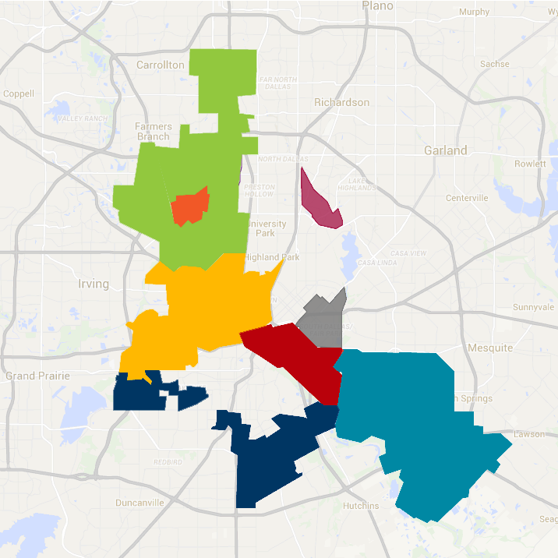
“If I send an A student home to an F community, all of a sudden he has a C life.”
Public-Private Partnership (P3) Network
8 place-based backbones collectively representing 76,770 students, 52 years of experience, 348 partners and 39 staff members aligning on common strategies
1 learning community to exchange promising practices, identify and access shared supports and align behind shared outcomes
ZFFC/Bachman Lake Together
Vickery Meadow Youth Development Foundation
Jubilee Park
The School Zone
WINS
Collaborative A.C.T.I.O.N.
Commit! Partnership

Slide 25
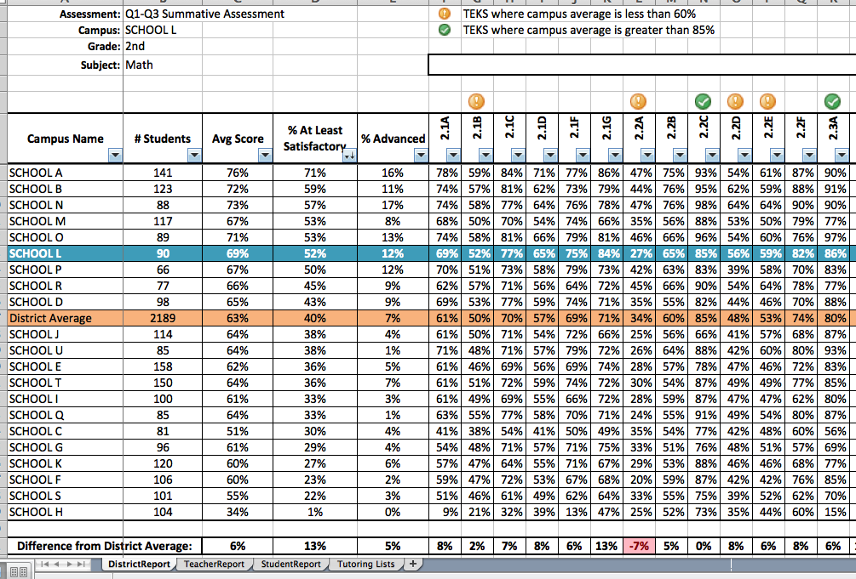
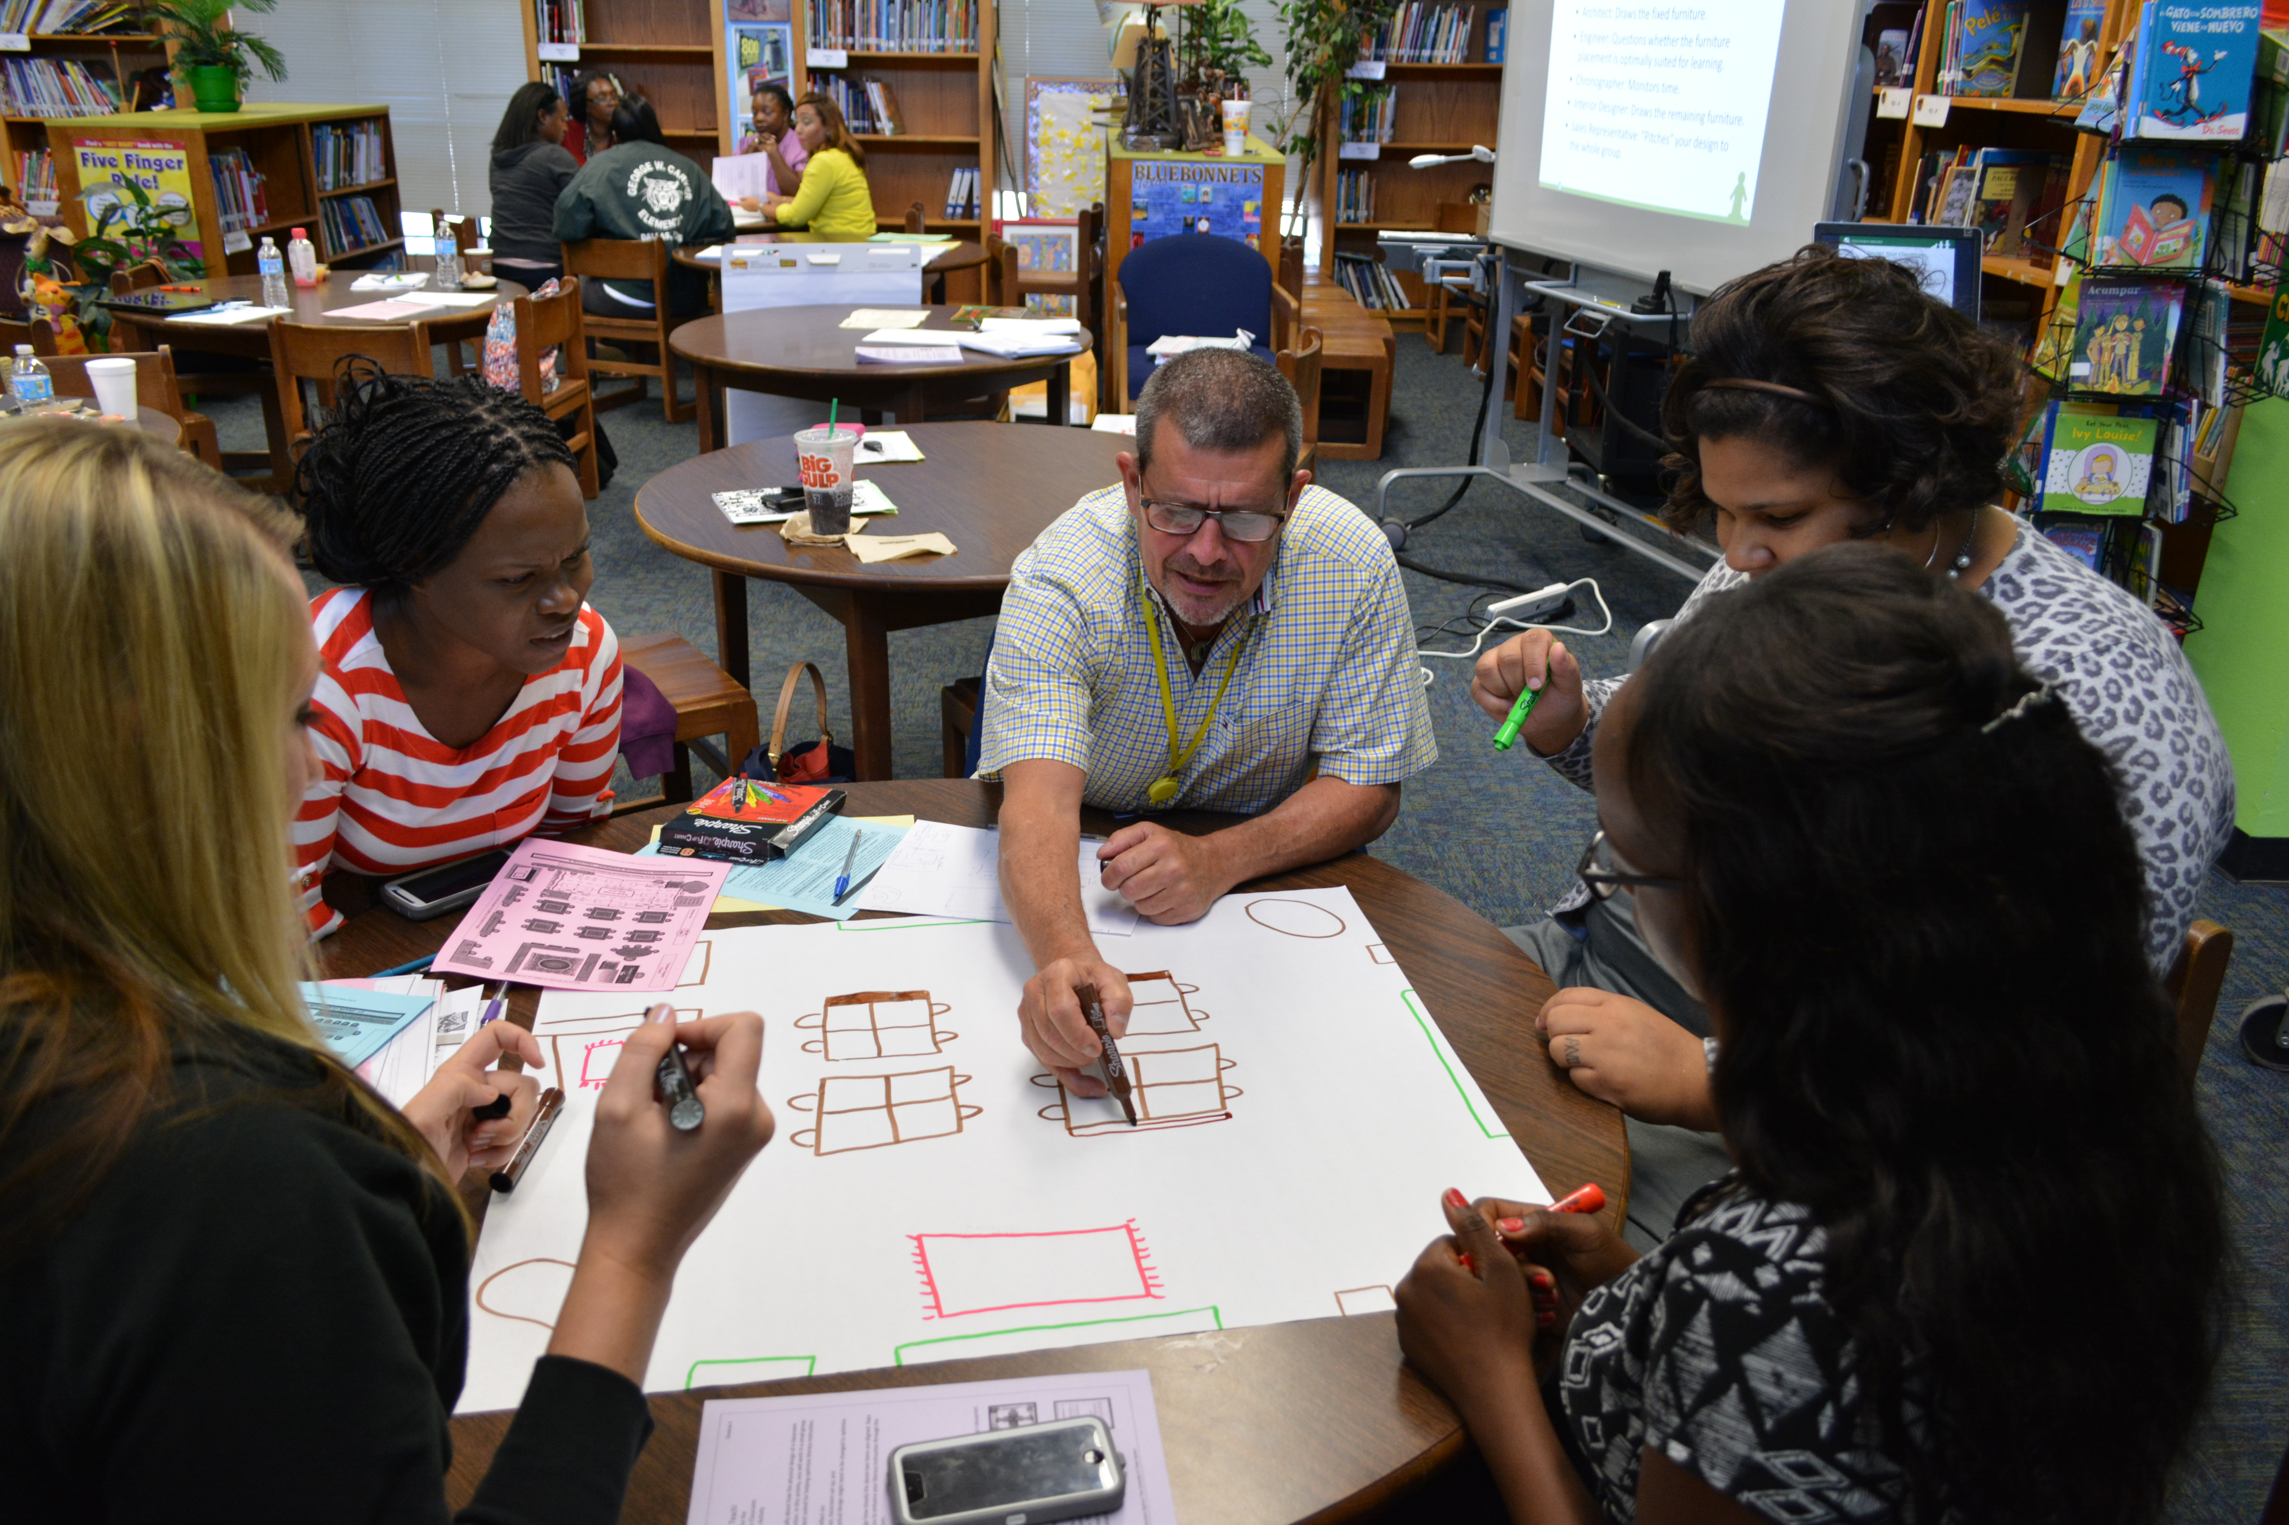
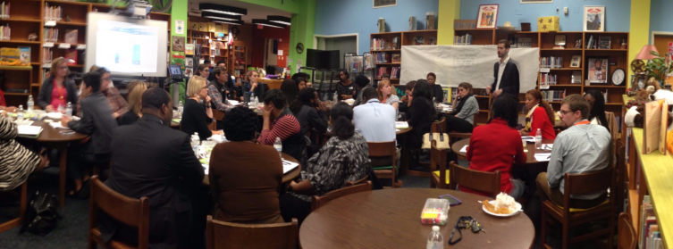
South Oak Cliff Early Learning Network
What Actions is the Partnership Taking?
Working with school leaders to use data to drive decision-making
Piloting reading and math learning communities to improve teacher instruction
Catalyzing partnerships to engage students in- and out-of-school

Slide 26

SOC significantly increased # of students registering early for pre-K in 2015
115
more students registered compared to last year
Source: SOC elementary school enrollment reports DISD
Notes:
MOLINA: 384 eligible 4-year-olds (+53 vs. last year, closing the enrollment gap); actual 308, still need 23 additional students to enroll to match last year, and 76 students to reach the goal

Slide 27
76% of students in SOC summer network did not experience summer learning loss
 |  | Summer Slide?
Provider | # of Pre-K-5 students served | Yes | No | Net
Center A | 9 | 0% | 100% | +100%
Center B | 35 | 11% | 89% | +78%
Center C | 34 | 15% | 85% | +70%
Center D | 32 | 38% | 63% | +25%
Center E | 12 | 67% | 33% | -34%
Grand Total | 122 | 24% | 76% | +52%
Istation provided trained teachers to Centers B & C. Teachers provided Istation support and small group instruction to students.

Slide 28

SOC increased student literacy growth across the board since 2012-13
Difference 2014-15 vs. 2012-13
 | +15%
 | +10%
*Percentile Growth | % of K-3 students growing 10 percentile points or more
Source: DISD ISIP K-3 English data. Students with at least one complete Spanish tier in September, October, January, April or May removed from the analysis.

Slide 29

BACHMAN LAKE TOGETHER

Slide 30
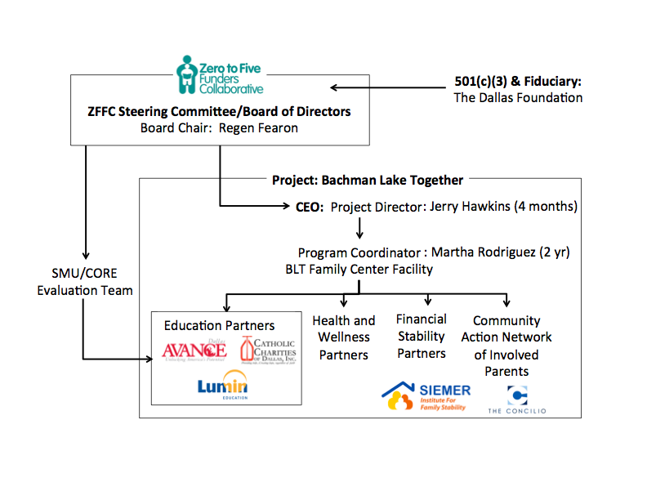
ZFFC/Bachman Lake Together
Organizational Structure

Slide 31
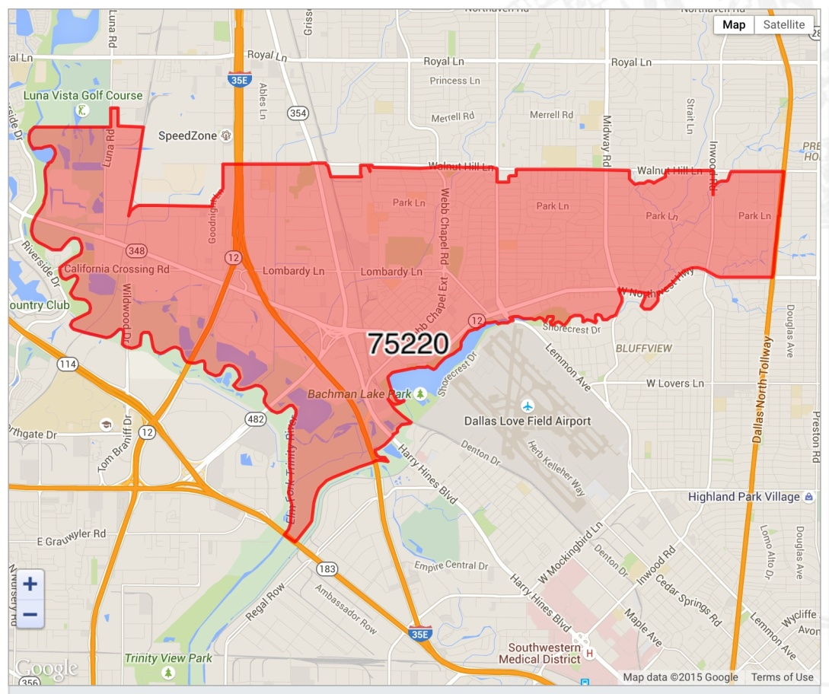
2010-13 BOUNDARY MAP & STATS FOR
ZIP CODE 75220
Population - 41,891 (Source: 2010 Demographic Profile)
Foreign Born Population - 20,763 (Source: 2009-2013 American Community Survey 5-Year Estimates)
Under 5 years - 4,521 or 10.8%
Hispanic or Latino (of any race) - 33,157 or 79.2%
Children in households for whom poverty status is determined - 13,294
In renter-occupied housing units - 77.2%
HOUSING: Total housing units -15,580, Occupied housing - 13,895, Vacant housing - 1,685

Slide 32
TOTALS OF CHILDREN AND PARENTS SERVED BY BACHMAN LAKE TOGETHER
Year 1 Totals: 481 children & 647 parents
Year 2 Totals: 1,167 children & 1,004 parents
Year 3 Totals: 1,034 children & 1,114 parents
Year 4 Totals: 1,390 children & 1,382 parents
Year 5 Totals: 1,087 children & 1,269 parents
Estimated Year 6 Totals: 1200 children & 1600 parents
YRS 1-6 TOTALS: 6200 children & 7500 parents (Estimated)

Slide 33
Parent as Change Agent
All of these are important because my daughters are learning while I am learning. I am learning English and because I am shy, the leadership classes help me feel more confident and have a healthy self-esteem. CAN is important because I learn that there are resources and ways that I can help my community. All of these programs help me be a better leader at home and then take my leadership skills to the community. My daughters are learning how to be leaders because I am setting the example.
-Iris Romo

Slide 34
A Principal’s Testimonial
I can tell which children have been touched by one of the Collaborative programs because they are ready for school. They know their letters, how to write their names, and generally have the social skills to make the best of a classroom setting. The Collaborative parents are, by far, our most engaged. Clearly, the Collaborative has made the difference in our neighborhood.
– Bachman Lake elementary school principal

